Slide 1





-PROJECT
Submitted To : Ms. Shefali Arora
Submitted By:
Aditya Bhartiya ~ Roll No. 21103003
Harchet Singh ~ Roll No. 21103055
Sorav Sharma ~ Roll No. 21103143
BEYOND BETTER!

Slide 2

Arithmetic
Trigonometric
Conversions
Matrix Related Work
Geometry
Complex Numbers
Linear Equations
Quadratic Equations
Vector Functions
Graph related Work
Stores History
Intro and Functions it can perform

Slide 3
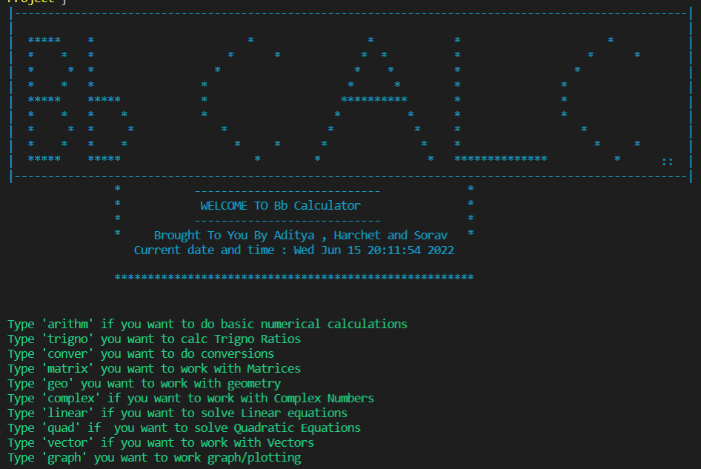
FRONT PAGE

Slide 4
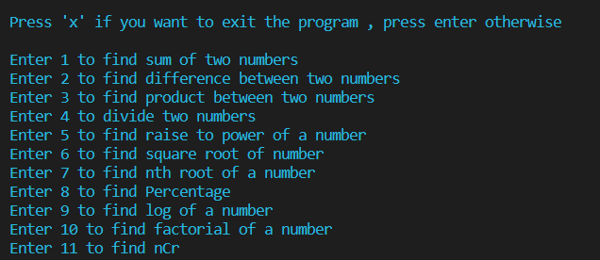
ARITHMeTIC (BASIC CALCULATIONS)
Sum
Difference
Product
Divide
Power
Square root
Nth root
Percentage
Log
Factorial
nCr

Slide 5
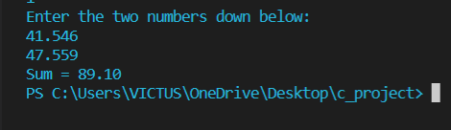
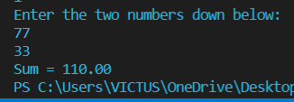
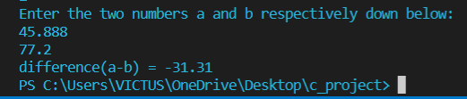
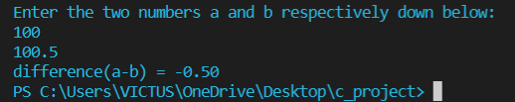
SUm
DIFFERENCE

Slide 6




PRODUCT
DIVIDE

Slide 7




POWER
SQUARE ROOT

Slide 8




Nth root
PERCENTAGE

Slide 9




LOG
FACTORIAL

Slide 10



NcR

Slide 11
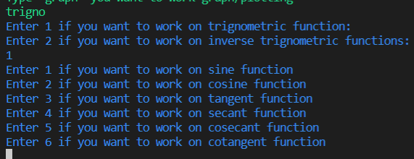
TRIGONOMETRIC FUNCTIONS
TRIGONOMETRIC FXN
INVERSE TRIGONO FXN

Slide 12



Trigono fxns
Sine
Cosine
Tangent
Similarly for cosecant, secant and cotangent.....

Slide 13
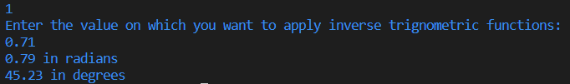


Inverse Trigono fxns
Inverse Sine
Inverse Cosine
Inverse Tangent
Similarly for the rest inverse fxns

Slide 14
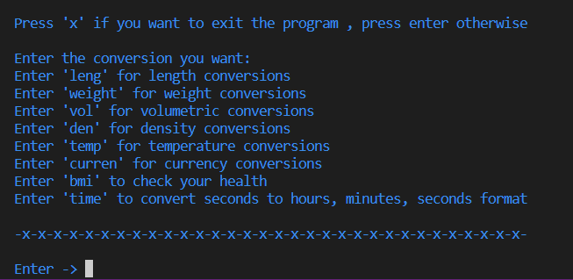
CONVERSIONS
Length
Volume
Density
Weight
Temperature
BMI
Time
Currency

Slide 15
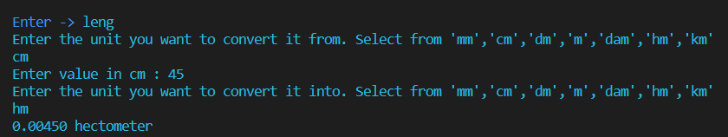
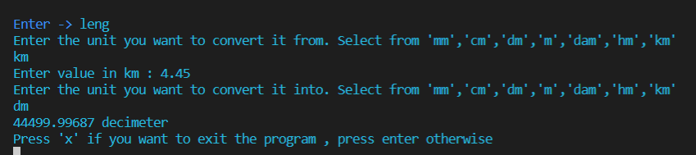
LENGTH
Cm→hecometer
Km→decimeter

Slide 16
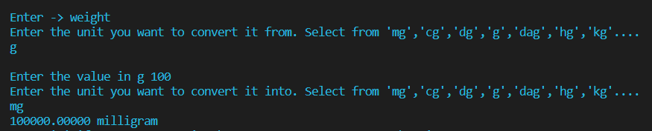
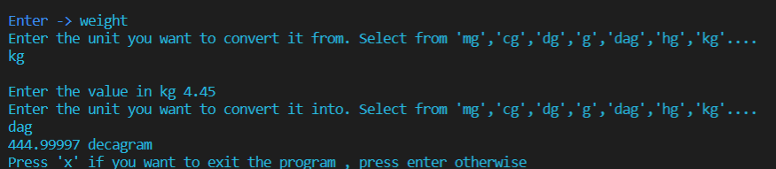
WEIGHT
Grams→Milligrams
Kilograms→Decagrams

Slide 17
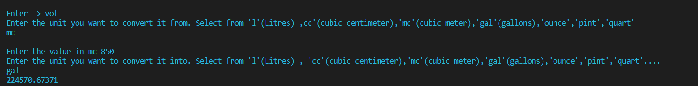
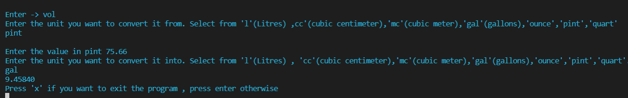
VOLUME
Milli litres → gallons
Pints → gallons

Slide 18
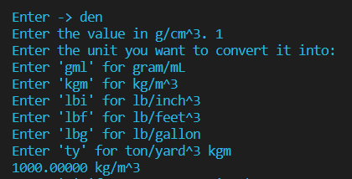
DENSITY

Slide 19

TEMPERATURE

Slide 20
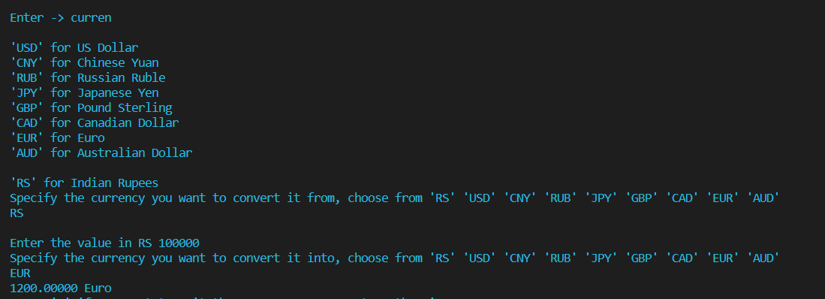
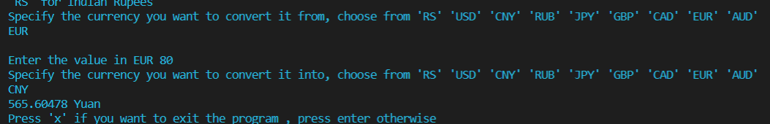
CURRENCY

Slide 21
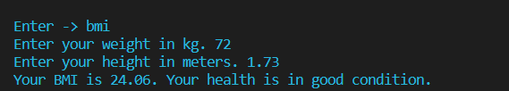

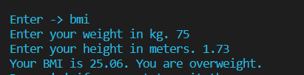
bmi

Slide 22


time

Slide 23
MATRIX
Multiplying the matrix by a constant number
Dividing the matrix by a constant number
Adding matrices
Subtracting matrices
Trace
Transpose
Multiplying 2 matrices
Square
Determinant
Inverse
Rank
Characteristic Equation
4X3

Slide 24
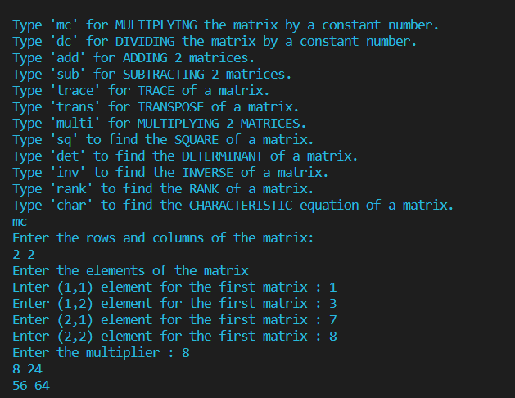
MULTIPLYING BY CONSTANT

Slide 25
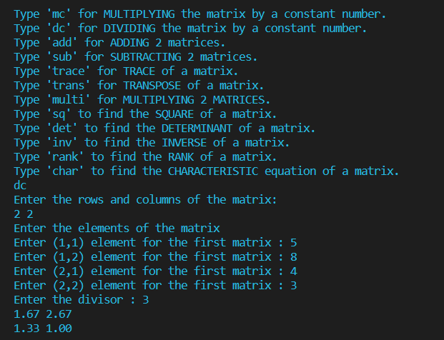
DIVIDING BY CONSTANT

Slide 26
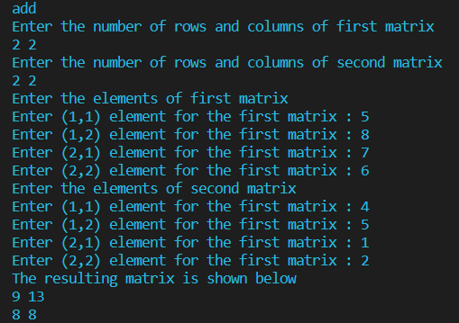
Matrix addition

Slide 27
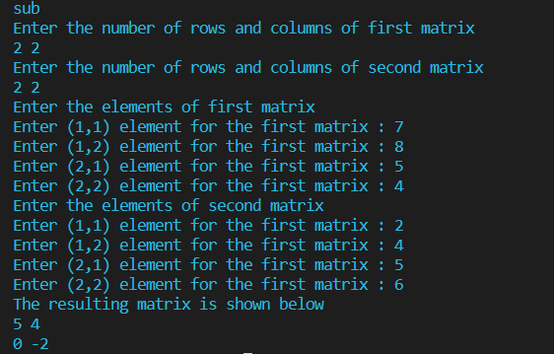
MATRIX SUBTRACTION

Slide 28
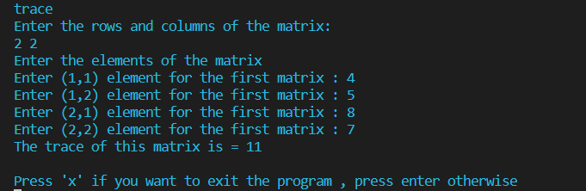
trace

Slide 29
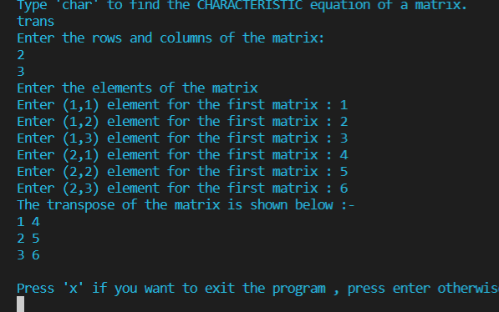
TRANSPOSE

Slide 30
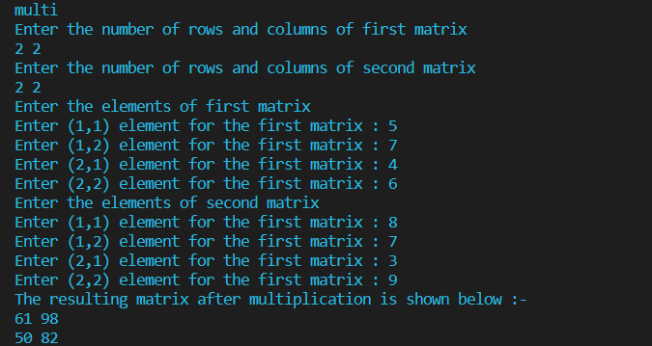
MATRIX MULTIPLICATION

Slide 31
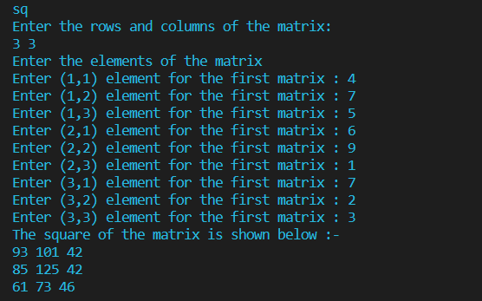
square

Slide 32
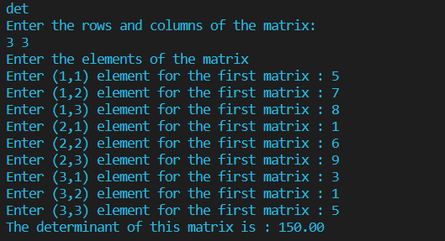
determinant

Slide 33
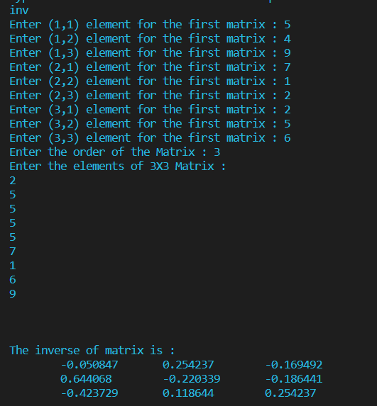
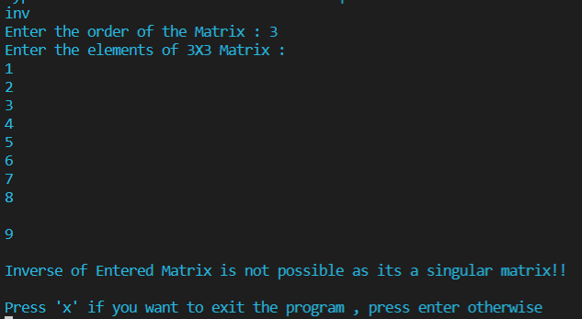
inverse

Slide 34
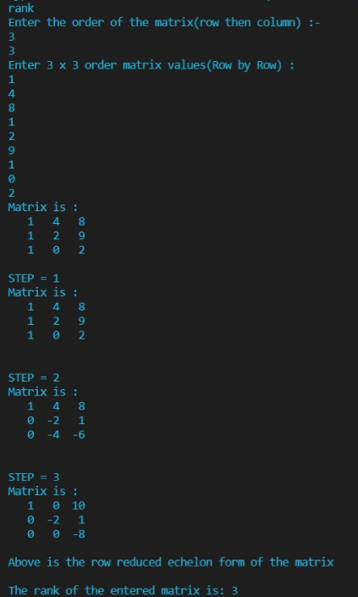
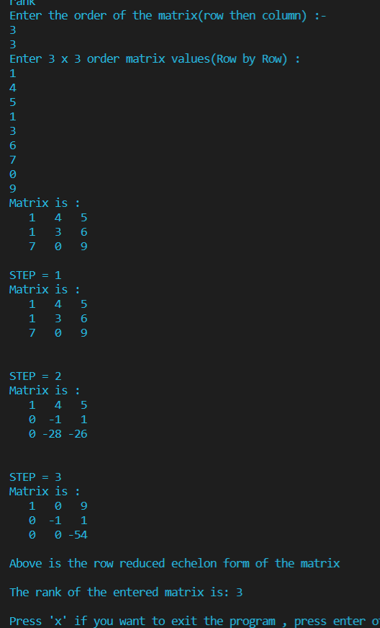
rank

Slide 35
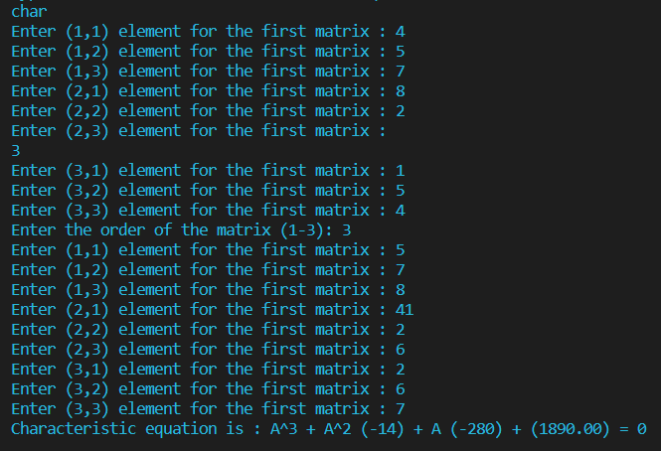
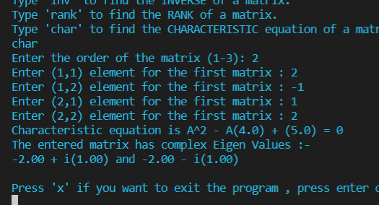
Characteristic equation
3X3
2X2

Slide 36
geometry
Circle
Square
Rectangle
Triangle
Cuboid
Cube
Sphere
Cone
Cylinder
Hemisphere

Slide 37
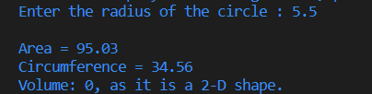

CIrcle
SQUARE

Slide 38
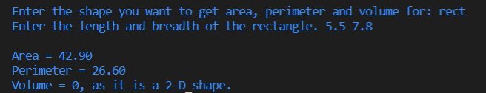
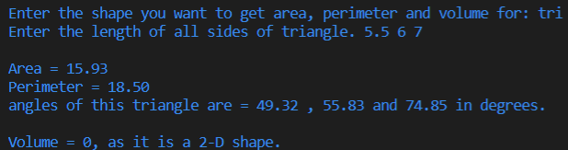
Rectangle
TRIANGLE

Slide 39
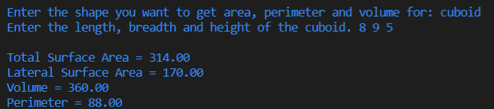
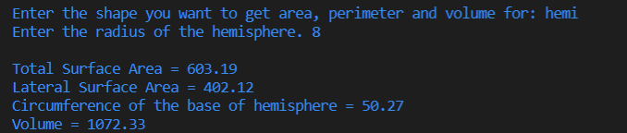
cuboid
HEMISPHERE

Slide 40
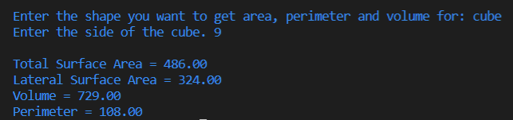
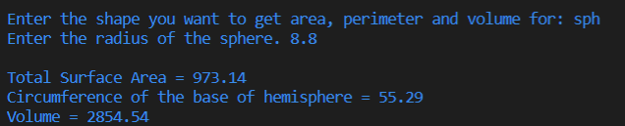
cube
SPHERE

Slide 41
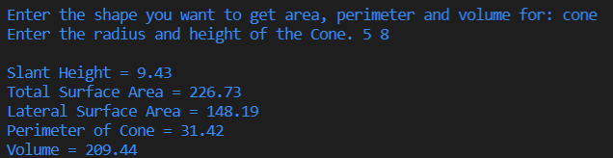
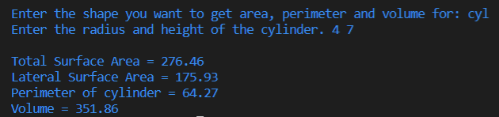
cone
CYLINDER

Slide 42
COMPLEX NUMBERS
Subtract
Power of iota
Conjugate
Amplitude
Multiply
Add
Divide
Euler Form
Polar Form
Argument

Slide 43
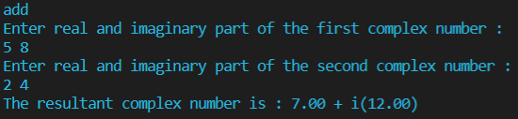
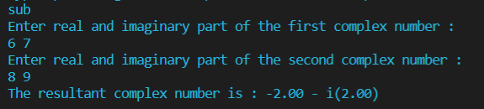
add
SUBTRACT

Slide 44


Power of iota
CONJUGATE

Slide 45

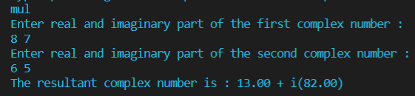
AMPLITUDE
MULTIPLICATION

Slide 46
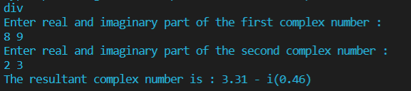

divide
ARGUMENT

Slide 47
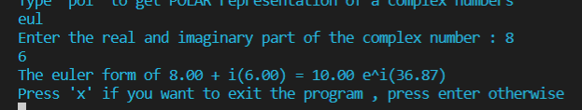
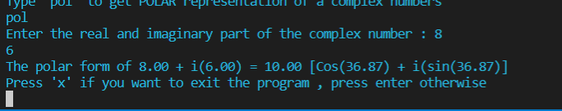
EULER FORM
POLAR FORM

Slide 48
LINEAR EQUations
Linear Equations with 2 variable
Linear Equations with 3 variables

Slide 49


Linear equations with 2 variables

Slide 50


LINEAR EQUATIONS WITH 3 VARIABLES

Slide 51


Quadratic equations

Slide 52
vectors
Add
Subtract
Dot Product
Cross Product
Magnitude
Scalar Triple Product
Vector Triple Product
Angle between 2 Vectors
Unit Vector

Slide 53


Addition of Vectors
SUBTRACTION OF VECTORS

Slide 54


DOT PRODUCT
CROSS PRODUCT

Slide 55


MAGNITUDE
ANGLE BETWEEN 2 VECTORS

Slide 56


SCALAR TRIPLE PRODUCT
VECTOR TRIPLE PRODUCT

Slide 57


UNIT VECTOR

Slide 58
GRAPH CALCULATIONS
Distance between 2 pts
Line passing through 2 pts
Slope
Intersection of lines
Line with pt. And slope
Distance between 2 lines
Circle passing through 3 points
Circle and its Equation
Angle between 2 lines
Triangle with 3 Vertices
Orthocenter of Triangle
Incentre of Triangle
Circumcenter of Triangle
Info of Quad with 4 vertices

Slide 59


Distance between 2 pts
LINE PASSING THROUGH 2 PTS

Slide 60


SLOPE
INTERSECTION OF LINES

Slide 61


LINE WITH PT. AND SLOPE
DISTANCE BETWEEN LINES

Slide 62



CIRCLE PASSING THROUGH 3 PTS
CIRCLE AND ITS EQUATION

Slide 63


Angle between 2 lines
TRIANGLE WITH 3 VERTICES

Slide 64


ORTHOCENTER
INCENTER

Slide 65

CIRCUMCENTER

Slide 66


INFO OF QUAD WITH VERTICEs

Slide 67


HISTORY STORED

Slide 68
THANKS!
U W U ~

